Slide 1
ARTIFICIAL INTELLIGENCE
&
MACHINE LEARNING
Session no: 1
Topic: Overview of AI, history, and ITS applications

Slide 2
Over of AI
Artificial Intelligence is composed of two words Artificial and Intelligence, where Artificial defines “Man-Made," and intelligence defines “Thinking Power", hence AI means “A man-made thinking power.“
Definition:
Artificial Intelligence (AI) refers to the simulation of human intelligence in machines that are programmed to think and learn.

Slide 3
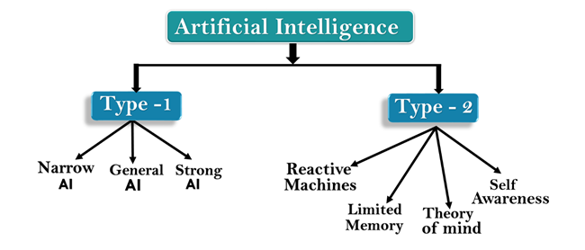
Types of Artificial Intelligence
Artificial Intelligence can be divided into TWO types, based on Capabilities and based on Functionality of AI.

Slide 4
Type-1: Based on Capabilities
1. Narrow AI:
Narrow AI is a type of AI which is able to perform a dedicated task with intelligence.
Examples: Playing chess, Speech recognition, image recognition, and Purchasing suggestions on e-commerce site.
2. General AI:
The idea behind the general AI to make such a system which could be smarter and think like a human by its own.
Examples: Self-Driving car
3. Strong AI:
Intelligent systems that can surpass human intelligence, and can perform any task better than human with cognitive properties.
Examples: Ability to think, to reason, solve the puzzle, make judgments, plan, learn, and communicate by its own.

Slide 5
Type-2: Based on Functionality
                1. Reactive Machines:
                These machines focus only on current scenarios and react on it as per possible best action.
                Examples: IBM's Deep Blue system, Google's AlphaGo.
2. Limited Memory:
These machines can store past experiences or some data for a short period of time
Example: Self-Driving car store recent s peed of nearby cars, the distance of other cars, speed limit, information to navigate the road.
3.Theory of Mind:
This type of AI machines understand the human emotions, people, beliefs, and be able to interact socially like humans. Example: Under developing.
4. Self-Awareness:
These machines will be super intelligent, and will have their own consciousness, sentiments, and self-awareness. These machines will be smarter than human mind.
Example: Under developing.

Slide 6
AI Technologies and Tools
Algorithms: Decision trees, clustering, neural networks.
Programming Languages: Python, R, Java.
Frameworks and Libraries: TensorFlow, PyTorch, Keras.

Slide 7
history of AI
The Birth of AI (1950s)
1950: Alan Turing
  Introduced the Turing Test and Proposed the idea of a "Computing Machinery and Intelligence“
1956: Dartmouth Conference
John McCarthy Who coined the term in 1956, defines it as “The Science and Engineering of making intelligent machines, especially intelligent computer programs.”

Slide 8
history of AI: The Golden Years (1960-1970)
Optimism and Progress:
  ELIZA (1966): Created by Joseph Weizenbaum, a natural language processing computer program that simulated conversation.
  Shakey the Robot (1966-1972): First general-purpose mobile robot able to reason about its actions.
Early AI Applications: Development of systems for medical diagnosis, symbolic mathematics, and chess playing.

Slide 9
history of AI: The Rise of Modern AI (2000s-Present)
Machine Learning: Rise of new algorithms and techniques for data-driven learning.
Big Data and Improved Algorithms: Enhanced computational power and access to large datasets.
Key Innovations:
  Deep Learning: Use of deep neural networks for image and speech recognition.
  AI in Everyday Life: Virtual assistants (Siri, Alexa), autonomous vehicles, recommendation systems.
Milestones:
  IBM Watson (2011): Won Jeopardy! against human champions.
  AlphaGo (2016): Developed by DeepMind, defeated the world champion Go player

Slide 10
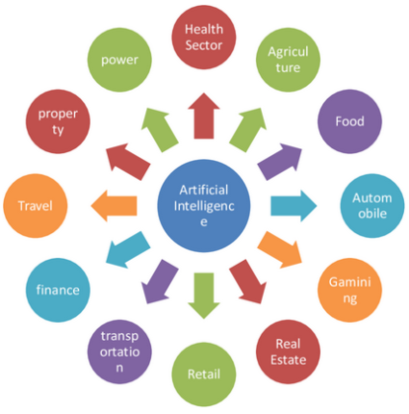
Applications of AI
1. Game Plying
2. Medical Diagnosis, Autonomous Control,
3. Autonomous Planning and Scheduling
4. Expert Systems
5. Robotics
6. Natural Language Processing
7. Computer Vision
8. e- Commerce

Slide 11
Applications of AI in Healthcare
Diagnostics:
  Medical Imaging: AI algorithms analyze X-rays, MRIs, and CT scans to detect diseases like cancer, fractures, and infections.
  Pathology: AI systems assist in examining tissue samples for accurate diagnosis.
Personalized Medicine: AI analyzes patient data to tailor treatments to individual genetic profiles and health histories.
Robotic Surgery: Robots like da Vinci Surgical System enhance precision in complex surgeries, reducing recovery times and improving outcomes.
Drug Discovery: AI accelerates the process of discovering new drugs by predicting molecular interactions and potential side effects.

Slide 12
Applications of AI in Finance
Fraud Detection: AI systems monitor transactions in real-time to identify suspicious activities and prevent fraud.
Algorithmic Trading: AI algorithms analyze market data and execute trades at high speeds, optimizing investment strategies.
Risk Management: AI assesses credit scores and loan eligibility, helping financial institutions manage risks.
Customer Service: Chatbots and virtual assistants handle customer inquiries, providing efficient and accurate responses.

Slide 13
Applications of AI in Agriculture
Precision Farming: AI analyzes data from soil sensors, weather forecasts, and crop health to optimize farming practices.
Crop Monitoring: Drones equipped with AI analyze aerial images to detect diseases and pests in crops.
Yield Prediction: AI models predict crop yields, helping farmers make informed decisions about planting and harvesting.

Slide 14
Applications of AI in Education
Personalized Learning: AI systems adapt educational content to the learning pace and style of individual students.
Tutoring Systems: AI-powered tutors provide additional support and resources to students outside of the classroom.
Administrative Tasks: AI automates grading, scheduling, and other administrative tasks, freeing up time for educators.

Slide 15
Applications of AI in Transportation
Autonomous Vehicles: AI powers self-driving cars by processing data from sensors and cameras to navigate safely.
Traffic Management: AI systems analyse traffic patterns to optimize signal timings and reduce congestion.
Logistics and Supply Chain: AI optimizes routes for delivery trucks, manages inventory levels, and predicts demand.

Slide 16
Applications of AI in Smart Homes and Cities
Home Automation: AI controls home devices such as lights, thermostats, and security systems for convenience and energy efficiency.
Smart Grids: AI optimizes energy distribution and usage in power grids, enhancing sustainability.
Urban Planning: AI analyzes data on traffic, pollution, and population to improve city planning and infrastructure.

Slide 17
What AI can do now a days
Autonomous planning and scheduling: NASA's Remote Agent program became the first on-board autonomous planning program.
Game playing: IBM's Deep Blue became the first computer program to defeat the world champion in a chess match when it bested Garry Kasparov by a score of 3.5 to 2.5 .
Autonomous control: The ALVINN computer vision system was trained to steer a car to keep it following a lane.
Diagnosis: Medical diagnosis programs based on probabilistic analysis have been able to perform at the level of an expert physician in several areas of medicine.
Logistics Planning: During the Persian Gulf crisis of 1991, U.S. forces deployed a Dynamic Analysis and preplanning Tool, DART to do automated logistics planning and scheduling for transportation.
Robotics: Many surgeons now use robot assistants in microsurgery. HipNav is a system that uses computer vision techniques to create a three-dimensional model of a patient's internal anatomy and then uses robotic control to guide the insertion of a hip replacement prosthesis.
Language understanding and problem solving: PROVERB is a computer program that solves crossword puzzles better than humans.

Slide 18
Self assessment questions
AI Technology makes the machines to ……………………
Act like Human…
Think like Human…
Speak like Human…
All the above …
AI is a rapidly evolving field with vast potential to transform numerous aspects of society
True
False

Slide 19
Terminal questions
Define Artificial Intelligence (AI) and explain its significance in various fields.
Discuss the difference between narrow AI and general AI with suitable example
Sketch and Illustrate about types of AI with suitable example
Illustrate the role on AI In Healthcare and Education Field.

Slide 20
Reference books and web links
Text Books:
Russel and Norvig, ‘Artificial Intelligence’, third edition, Pearson Education, PHI, (2015)
Elaine Rich & Kevin Knight, ‘Artificial Intelligence’, 3nd Edition, Tata McGraw Hill Edition, Reprint (2008)
Web links:
https://www.geeksforgeeks.org/agents-artificial-intelligence/
https://www.simplilearn.com/what-is-intelligent-agent-in-ai-types-function-article
https://www.javatpoint.com/turing-test-in-ai
https://www.geeksforgeeks.org/turing-test-artificial-intelligence/
https://www.section.io/engineering-education/turing-test-in-ai/

